Slide 1

Crime Data Analysis in Chicago
Rohan Sattarapu

Slide 2

CONTENT
Introduction
Data Cleaning and Preprocessing
Exploratory Data Analysis(EDA)
Feature Engineering
Data Modelling
Time Series Analysis
Results
Conclusion

Slide 3

OBJECTIVE
In our project, we utilized crime and weather datasets from the city of Chicago.
We conducted an in-depth analysis of the crime data, exploring patterns and trends over time.
Additionally, we employed time series analysis techniques to model and understand the temporal aspects of the crime dataset.
The ultimate goal of our project is to predict future crime occurrences using machine learning models. By leveraging these models, we aim to forecast crime patterns based on various factors, ultimately contributing to a better understanding and potential prevention of criminal activities in the city.

Slide 4

Data Cleaning and Preprocessing

Slide 5

Data Cleaning
Eliminated null values for data completeness.
Filling Missing Values
Date formatting
Addressing Structural Errors
Correcting Values
Handling Outliers
Tools Used:
Spreadsheets Programs
Dedicated Data Cleaning Tools(Open Refine)
Programming Languages Data cleaning is critical because the quality of data determines the accuracy and efficiency of the subsequent analysis.

Slide 6
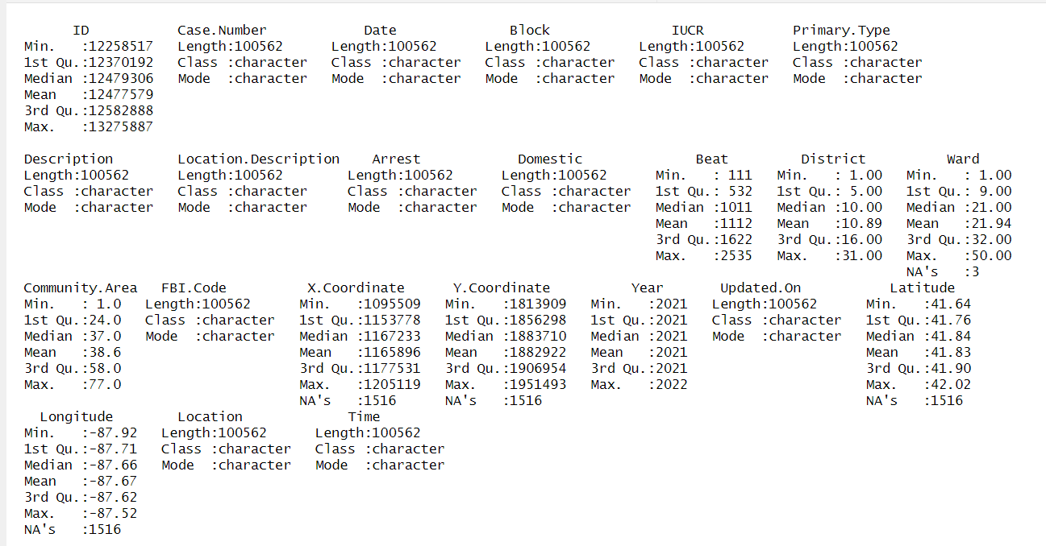
Chicago Crime Data Summary

Slide 7
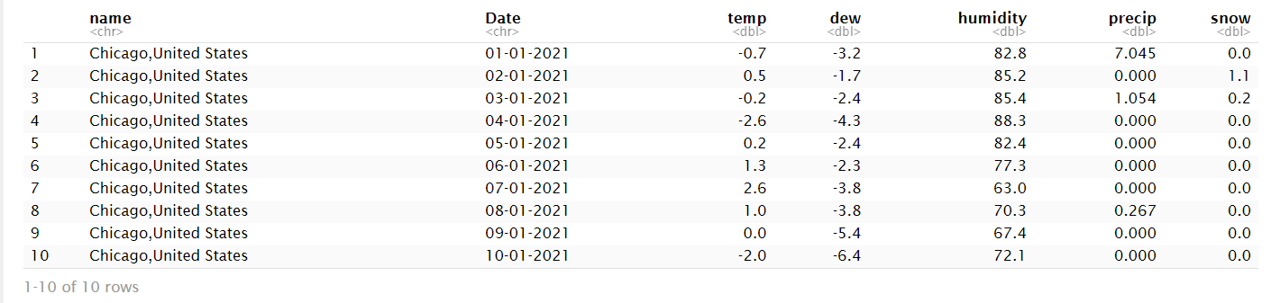
Weather Data Set

Slide 8
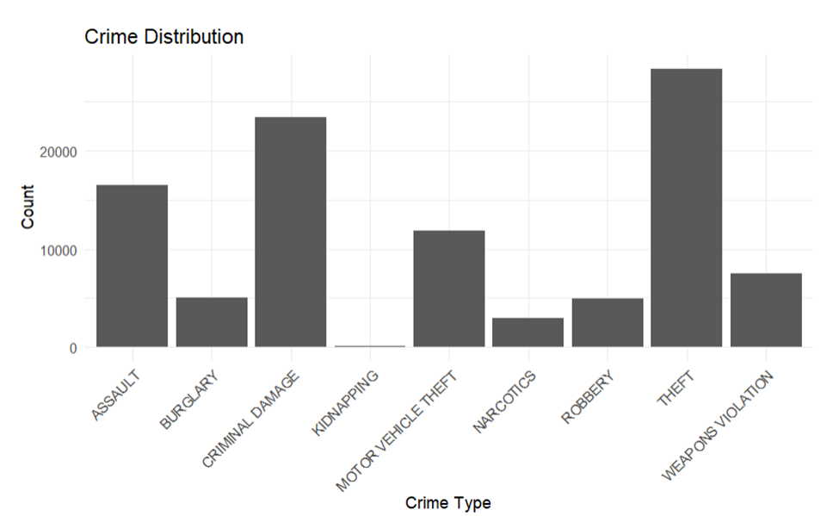
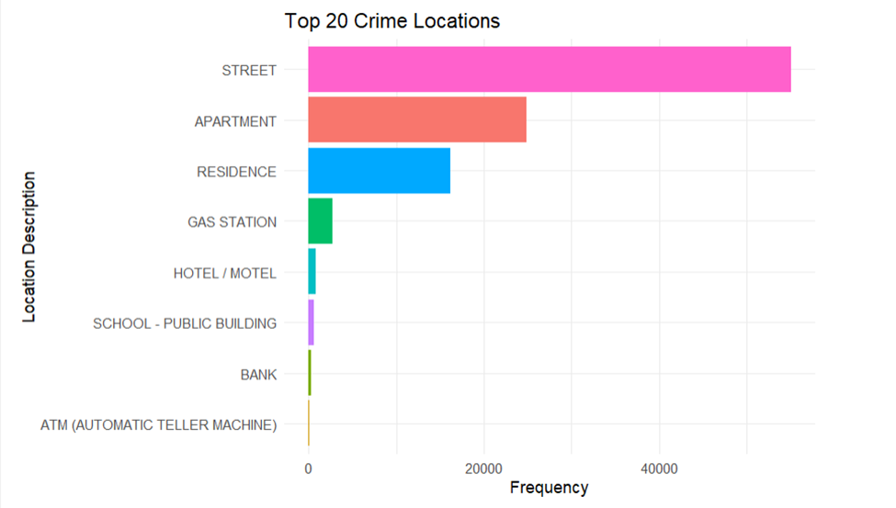
Exploratory Data Analysis

Slide 9
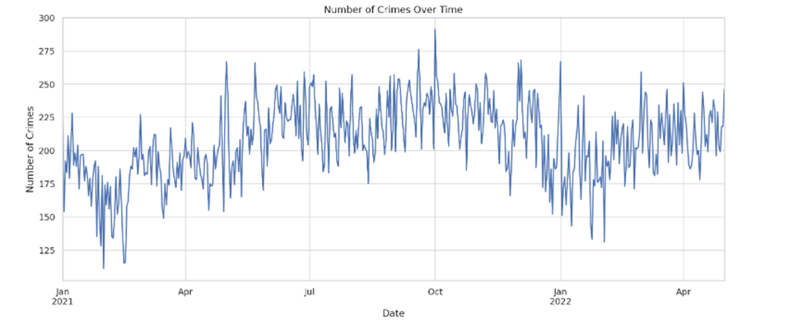
Date Vs Crime

Slide 10
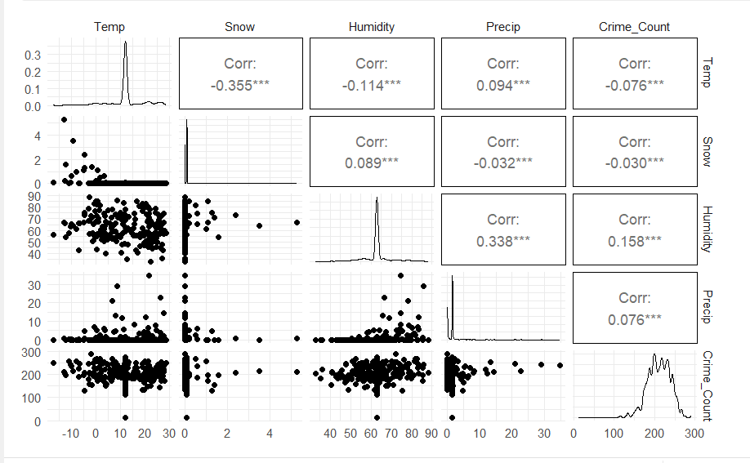
Correlation Plot

Slide 11
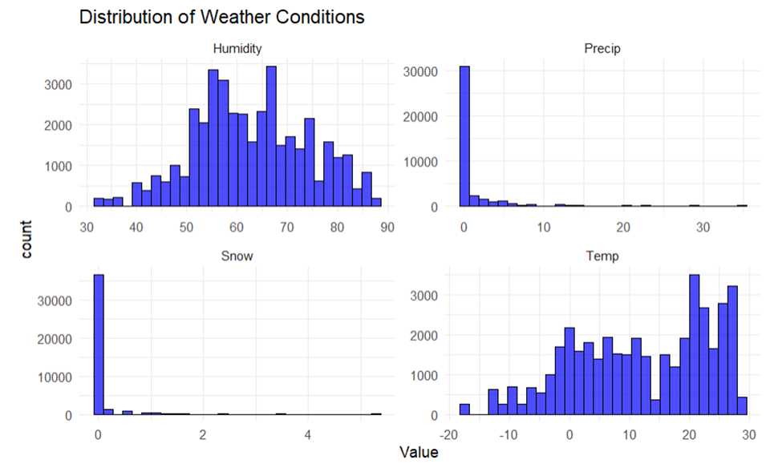
Feature Engineering:

Slide 12
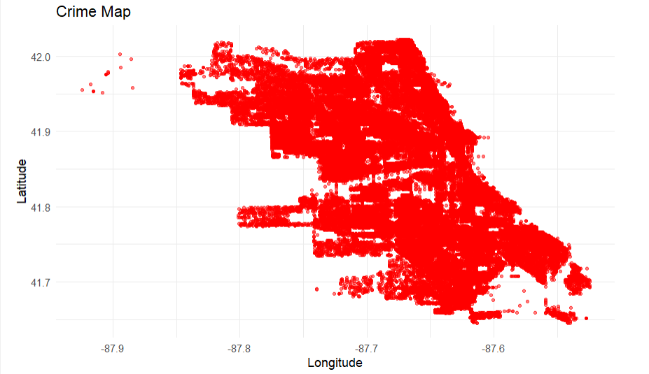
Crime Location

Slide 13
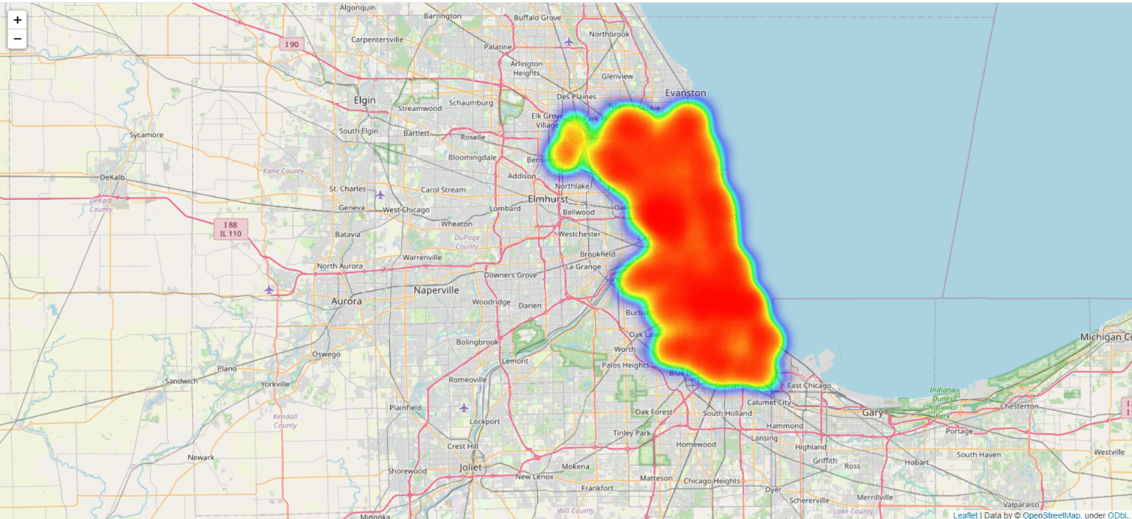
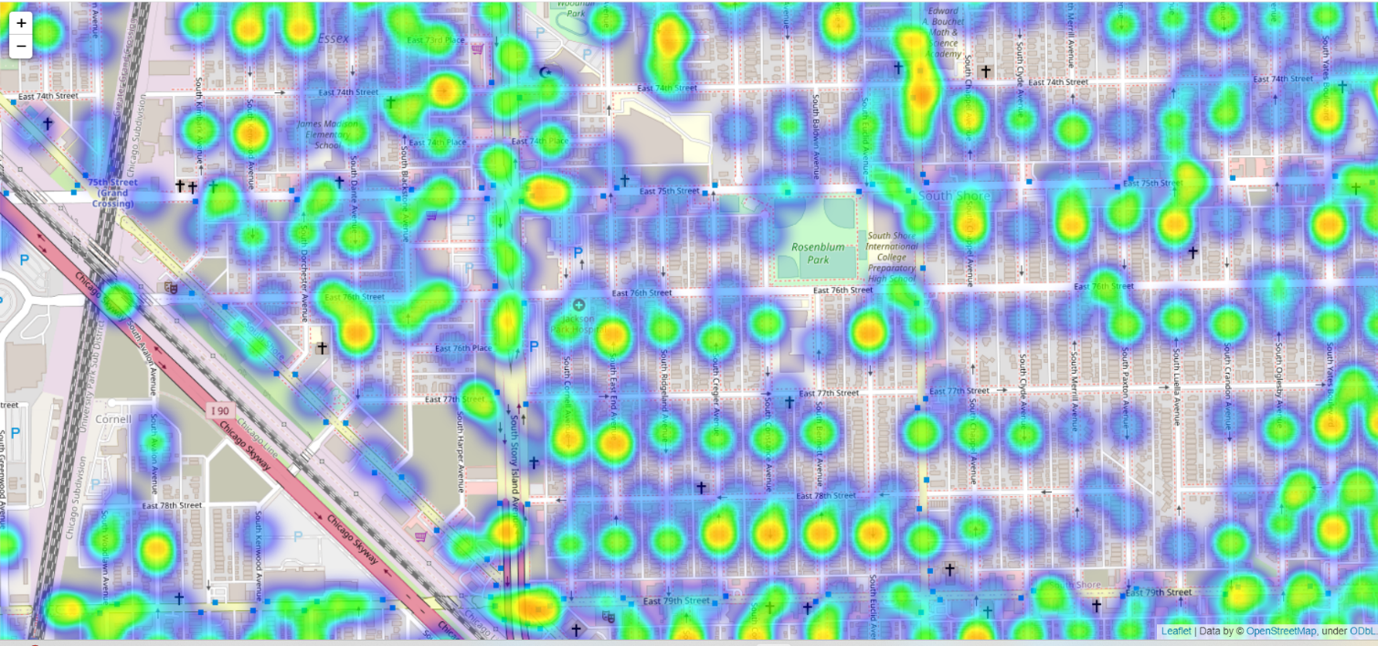
Street Crimes in Chicago

Slide 14
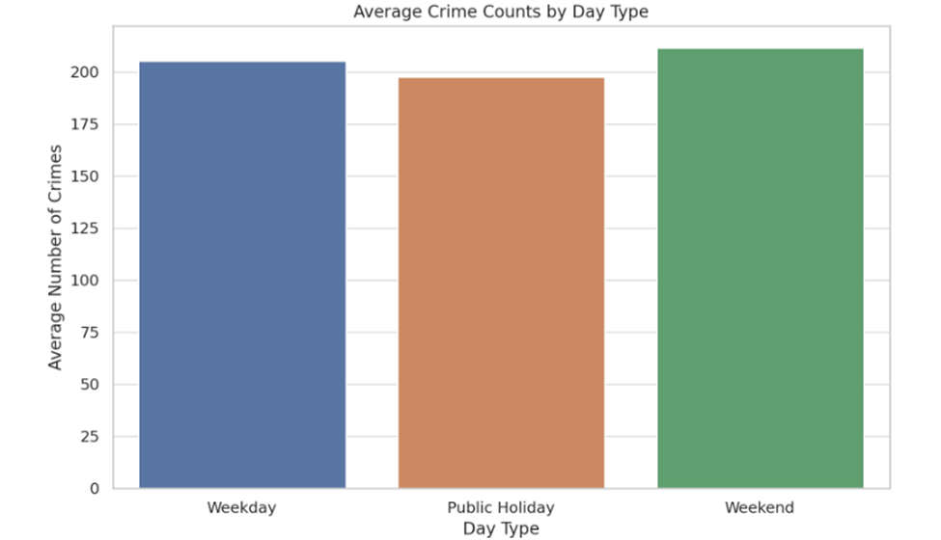
Crime Trends on Weekdays, Weekends and Holidays

Slide 15
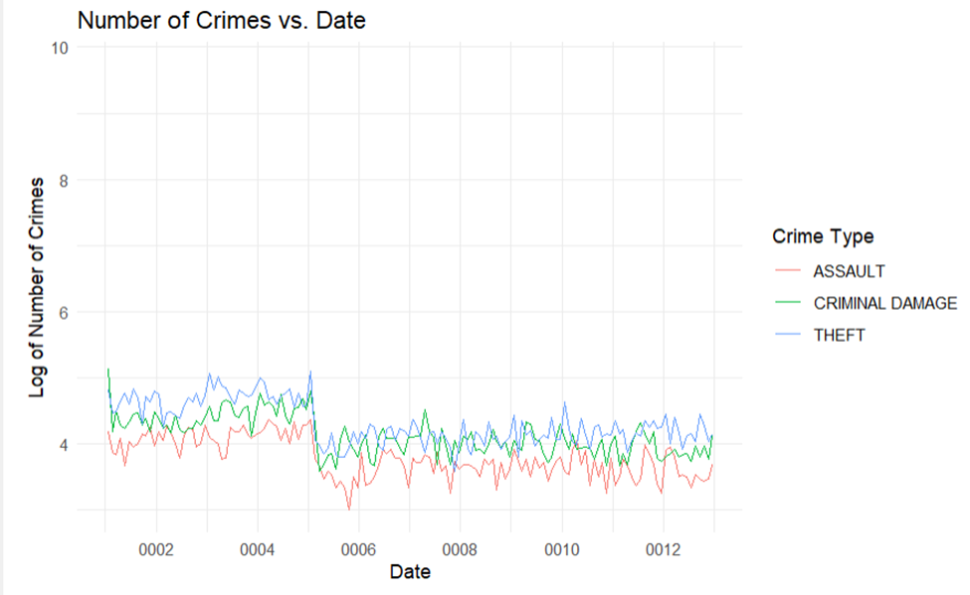
Top 3 Crimes in Chicago

Slide 16

Data Modelling

Slide 17
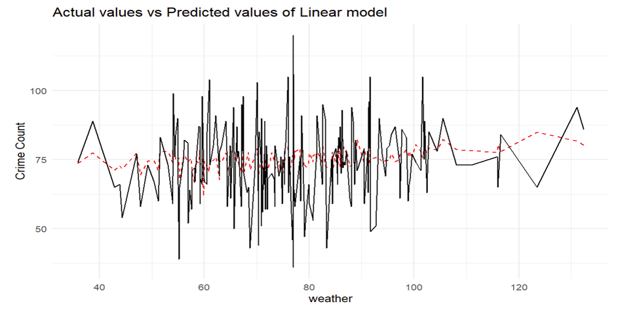
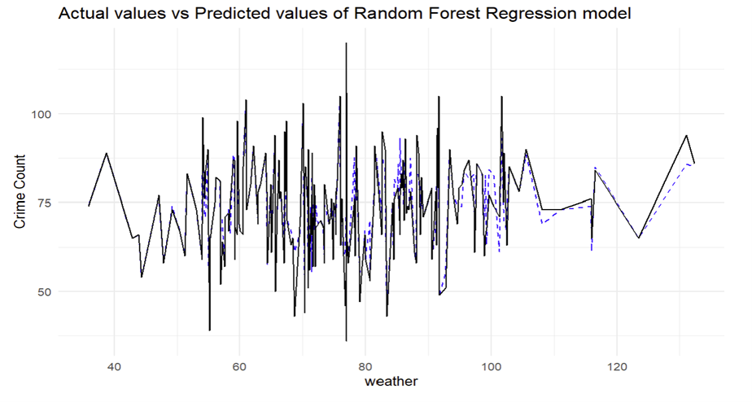
Regression Models
Linear Regression
Linear regression is a fundamental statistical and machine learning technique used to model the relationship between a dependent variable and one or more independent variables. The model assumes a linear relationship between these variables. It's widely used for prediction and forecasting where data shows a linear trend
Random Forest Regression
Random Forest Regression is an ensemble learning method used for regression tasks, which operates by building multiple decision trees during training and outputting the mean prediction of the individual trees. It's a powerful and versatile machine learning method that can be used for a wide variety of data types and prediction tasks.

Slide 18
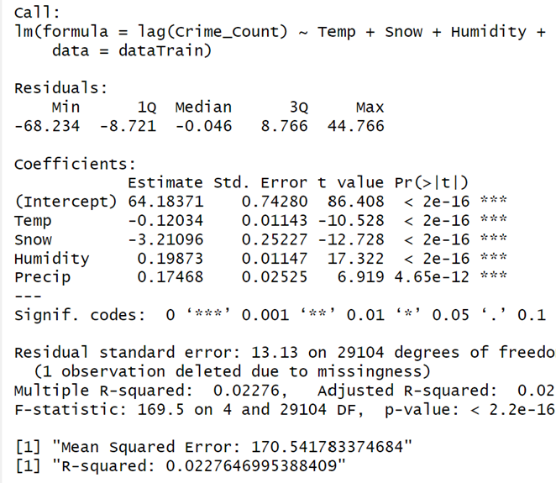
Linear regression summary model

Slide 19
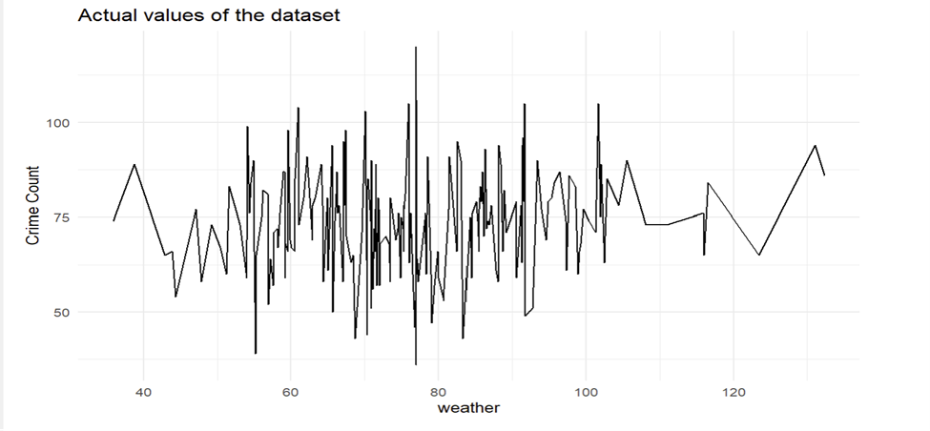
Linear Regression

Slide 20
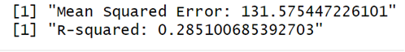
Random Forest Regression

Slide 21
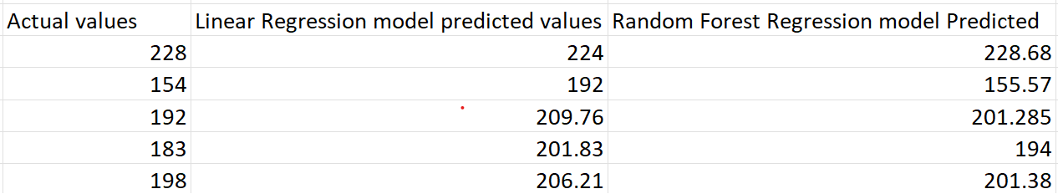
Comparison of Actual Values with Machine Learning Predicted Model Values

Slide 22
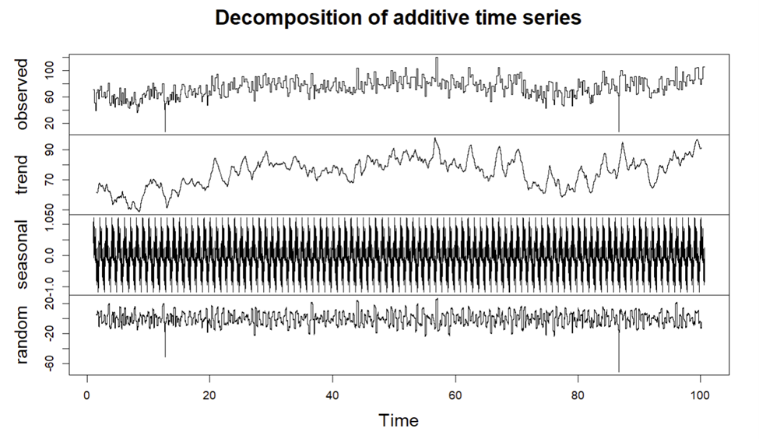
Time Series Analysis

Slide 23
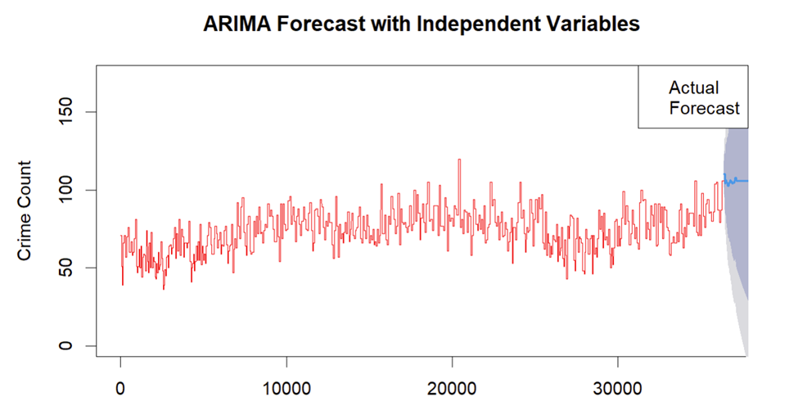
ARIMA Model

Slide 24
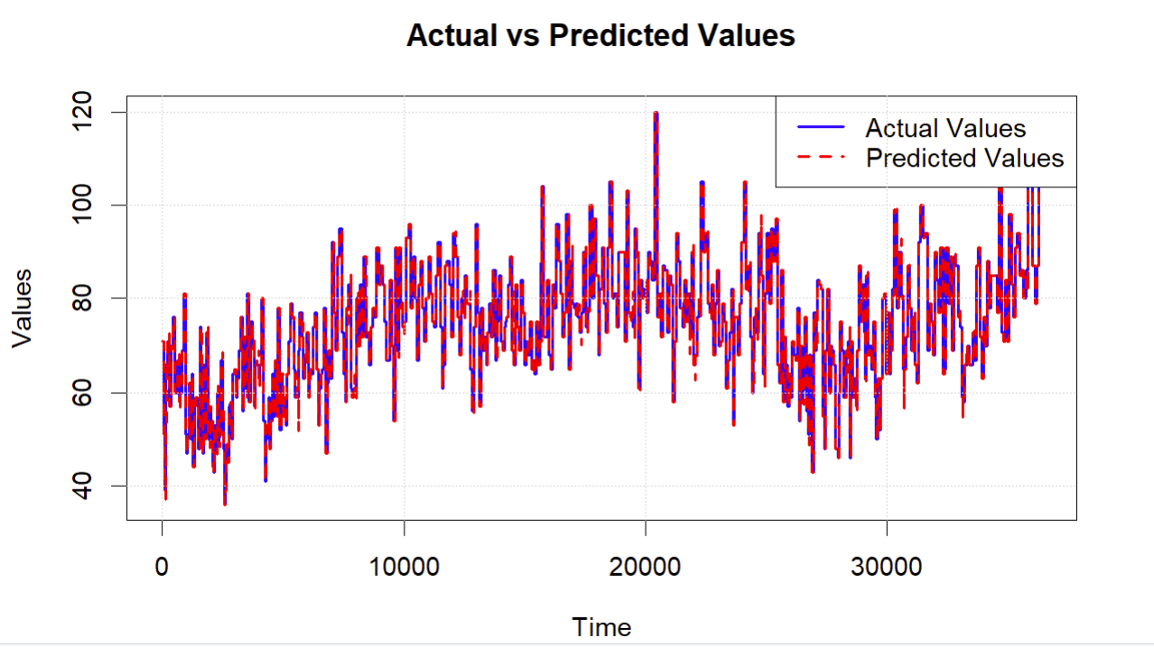

Slide 25
Advantages and Conclusion
Advantages of Crime Data Analysis:
Informed Decision-Making: Empowers law enforcement with data-driven insights.
Resource Allocation: Efficiently allocates resources to high-crime areas.
Predictive Policing: Anticipates and prevents criminal activities.
Community Engagement: Improves relations through transparency.
Conclusion:
Enhanced Public Safety: Identifies and addresses crime hotspots for community safety.
Optimized Policing Strategies: Fine-tunes tactics based on evolving crime patterns.
Continuous Improvement: Adapts strategies for ongoing effectiveness.
Collaboration and Information Sharing: Encourages unity among agencies for a stronger fight against crime.

Slide 26
Thank You

